Slide 1
Branch and bound
It is a kind of algorithm for you to show your capability

Slide 2
Introduction
Like backtracking, branch and bound searches a solution space that is often organized as a tree. The common tree organizations are the subset and permutation trees.
unlike backtracking, which searches these tree organizations in a depth-first manner, branch and bound usually searches these trees in either a breadth-first or least-cost manner.
Branch and bound algorithms are generally used for optimization problems
  A method is used to construct an upper and lower bound for a given problem
  At each node, apply the bounding function to kill node and extend node.
  Continue, using the best known feasible solution to trim sections of the tree, until all nodes have been solved or trimmed

Slide 3
Ideas
Branch-and-bound which is the natural improvement of backtracking for optimization problems.
Assume we are considering a minimization problem. The idea is to maintain at all times upper and lower bounds on the achievable values. If after a certain number of decisions (branching operations) we come to a node for which the lower bound is larger than or equal to an already established upper bound, then there is no need to further develop this branch. For maximization problems the rule is reversed: as soon as the upper bound is smaller than or equal to an earlier established lower bound the branch is cut.

Slide 4
Branch-and-bound is in the first place a method to prune the tree corresponding to feasible partial solutions of an optimization problem.
Try to focus the search on branches that appear most promising. That is, to first develop branches that, based on their lower and upper bounds and other criteria promise to lead to the best solutions. The rational is that developing such branches probably leads to finding improved lower and upper bounds, which allows to prune more of the other branches.
In general one does not perform a pure DFS or BFS search, but rather a tuned search.

Slide 5
The steps involved in the branch and bound method are
1. Define a solution space for the problem. This space must include at least one (optimal) solution to the problem.
2.Organize the solution space so that it can be searched easily.
The typical organization is either a graph or a tree.
3. Searched the solution space in a breadth-first manner using bounding functions to avoid moving into subspaces that cannot possibly lead to the answer.

Slide 6
Branch and bound is another way to systematically search a solution space. It differs from backtracking primarily in the way an E-node is expanded.
Each live node becomes an E-node exactly once. When a node becomes an E-node, all nodes that can be reached using a single move from it are generated. Generated nodes that cannot possibly lead to a (optimal) feasible solution are discarded (dead node). The remaining nodes are added to the list of live nodes, and then one node from this list is selected to become the next E-node.

Slide 7
The selected node is extracted from the list of live nodes and expanded. This expansion process is continued until either the answer is found or the list of live nodes becomes empty.
There are two common ways to select the next E-node (though other possibities exist):
1) First In, First Out (FIFO)
This scheme extracts nodes from the list of live nodes in the same order as they are put into it. The live node list behaves as a queue. Search the tree using a breadth-first search

Slide 8
Notice that a FIFO branch and bound differs from breadth-first is that FIFO branch and bound does not search subtrees of infeasible nodes.
2) Least Cost or Max Profit
Replace the FIFO queue with a priority queue. This scheme associates a cost or profit with each node. If we are searching for a solution with least cost, then the list of live nodes can be set up as a min heap. The next E-node is the live node with least cost. If we want a solution with maximum profit, the live node list can be set up as a max heap. The next E-node is the live node with maximum profit.

Slide 9
Solution space tree
extend node
dead node
x₁
live node
x₂
x₃
Success

Slide 10
Applying branch-and-bound requires specifying at least the following four points:
How to compute upper bounds (for maximum problem)
How to compute lower bounds (for minimum problem)
How to choose an item for the next branching operation
How to develop the search tree (BFS, DFS, ...)
Make use of the bounding function and the constraint function to prune invalid branches and to focus the search on branches that appear most promising.

Slide 11
Generally, for maximum problem, we compute the upper bound B(i) of the extend node i. If the current maximum objective value bestc is not less than B(i), then prune branch, otherwise, continue.
R
The objective value from root R to leaf L by i must be not bigger than B(i), so if B(i)≤bestc, then it show that searching the extend node i has no promising, so prune the extend node i, At the same time, the live node with maximum B(i) is priority to extend.
i
B(i)
L

Slide 12
Generally, for minimum problem, we compute the lower bound B(i) of the extend node i. If the current minimum objective value bestc is not bigger than B(i), then prune branch, otherwise, continue.
R
The objective value from root R to leaf L by i must be not less than B(i), so if B(i)≥bestc, then it show that searching the extend node i has no promising, so prune the extend node i, At the same time, the live node with maximum B(i) is priority to extend.
i
B(i)
L

Slide 13
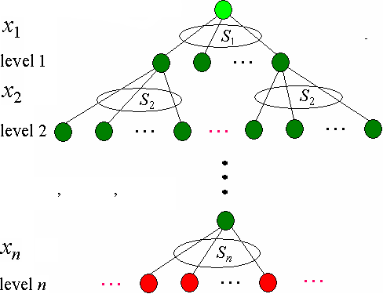
Subtree

Slide 14
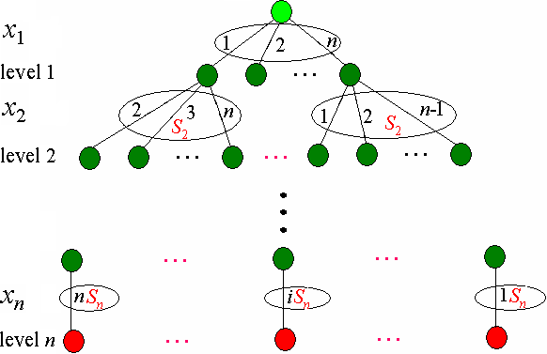
Permutation tree

Slide 15
2. Container Loading problem
Problem
Given n containers, container i has weight w_{i}. the ship can hold containers of total weight up to W.
Container Loading problem is to load as many containers as is possible without sinking the ship.
Solution space
Assuming that the solutions are represented by vectors (x₁,x₂,…,x_{n}), where x_{i}∈{0,1}, x_{i} =1 denotes container i are placed into the ship, x_{i} =0 denotes container i are not placed into the ship.

Slide 16
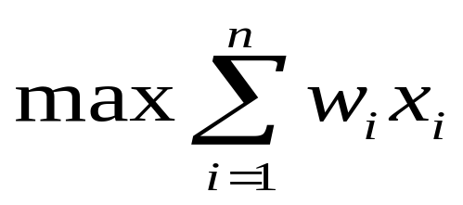
The container loading problem can be formally stated as follows:
The solution space tree
Subtree with 2^{n} leaves
At level j the members of the solution space are partitioned by their x_{j} values.

Slide 17
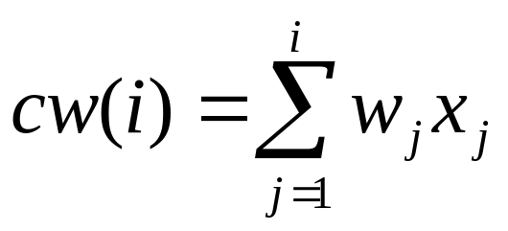
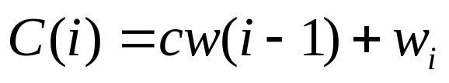

The constraint function
Let cw(i) denote the current weight of the extend node, namely
then the constraint function is
Pruning
if then stop search level i and the following level, otherwise, continue to search.

Slide 18
FIFO using constraint function
FIFOMaxLoading(w, W, n)
1 i ← 1
2 Enqueue(Q, -1)
3 cw ← 0; bestw ← 0
4 while Ø do
5 if C(i)≤W then
6 SaveQueue(Q, C(i), bestw, i)
7 SaveQueue(Q, cw, bestw, i)
8 cw←Dequeue(Q)
9 if cw = -1 then
10 if Ø then return bestw
11 Enqueue(Q, -1)
12 cw←Dequeue(Q)
13 i ← i+1
14 return bestw

Slide 19
SaveQueue(Q, wt, bestw, i)
1 if i=n then
2 if wt>bestw then
3 bestw←wt
4 else
5 Enqueue(Q, wt)

Slide 20
n=3,w=[8,6,2], W=12
extend node
dead node
C(i)
A
A
x₁
live node
1
0
B
B
C
B
C
C
x₂
1
0
1
0
G
F
G
E
F
G
14
E
F
D
E
x₃
1
0
1
0
1
0
J
J
K
K
L
L
M
M
N
N
O
H
I
J
K
L
M
N
O
O
10
Quene:
Congratulations! we made a success, so slowly!
-1
B
C
-1
E
F
G
-1
J
K
L
M
N
O
-1

Slide 21
n=3,w=[8,6,2], W=12
extend node
dead node
C(i)
A
x₁
live node
1
0
B
C
x₂
1
0
1
0
14
D
E
F
G
x₃
1
0
0
1
0
H
I
J
K
L
M
N
O
1
-1
Quene:
Congratulations! we made a success, so slowly!
-1
B
C
-1
E
F
G
-1
J
K
L
M
N
O
-1

Slide 22
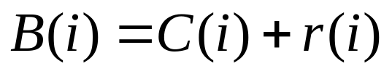
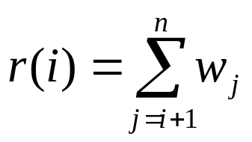

Improved FIFO
Make use of the bounding function
where, r(i) denotes the weight sum of the remaining containers, namely,
Pruning
if , then stop search level i and the following level, otherwise, continue to search. where, bestw denotes the best weight up to now

Slide 23
Improved FIFO
ImprovedFIFOMaxLoading(w, W, n)
1 i←1
2 Enqueue(Q, -1)
3 cw ← 0; bestw ← 0; r ←0
4 for j ← 2 to n do r ← r+w[j]
5 while Q≠Ø do
6 if C(i)≤W then
7 if C(i)>bestw then bestw←C(i)
8 if i<n then Enqueue(Q, C(i))
9 if B(i)>bestw and i<n then Enqueue(Q, cw)
10 cw←Dequeue(Q)
11 if cw = -1 then
12 if Q = Ø then return bestw
13 Enqueue(Q, -1)
14 cw←Dequeue(Q)
15 i ← i+1
16 r ← r-w[i]
17 return bestw

Slide 24
n=3,w=[8,6,2], W=12
extend node
dead node
8/8
0/8
A
A
14/2
x₁
live node
1
0
B
B
Bestw=8
B(1)=8
B
C
x₂
1
0
E
G
14
E
F
D
E
x₃
1
0
J
H
I
J
J
K
L
M
N
O
10
B(3)=8
Quene:
Congratulations! we made a success, so fast!
-1
B
-1
E
-1
J
-1

Slide 25
Construction optimal solution
SolutionFIFOMaxLoading( )
1 i ← 1
2 Enqueue(Q, -1)
3 cw ← 0; bestw ← 0; r ← 0
4 for j ← 2 to n do r ← r+w[j]
5 while Q≠Ø do
6 if C(i)≤W then // x[i] = 1
7 SaveQueue(Q, C(i), i, bestw, E, bestE, bestx, 1)
8 if B(i)>bestw then
9 SaveQueue(Q, cw, i, bestw, E, bestE, bestx, 0)
10 E←Dequeue(Q)
11 if E= -1 then
12 if Q = Ø then return bestw
13 Enqueue(Q, -1); E←Dequeue(Q); i←i+1; r←r-w[i]
14 cw←E.weight
15 for j←n-1 downto 1 do
16 bestx[j]←bestE.Lchild
17 bestE←bestE.parent
18 return bestw

Slide 26
SaveQueue(Q, wt, i, bestw, E, bestE, bestx, ch)
1 if i=n then
2 if wt>bestw then
3 bestE ← E
4 bestw ← wt
5 bestx[n] ← ch
6 else
7 b.weight ← wt
8 b.parent ← E
9 b.LChild ← ch
10 Enqueue(Q, b)

Slide 27

Max-profit branch-and-bound
The list of live nodes is a max-priority queue. Each live node x in the queue has an upper weight B(i) associated with it. This upper weight is the weight associated with the node x plus the weight of the remaining containers. Namely
where, the definition of C(i) and r(i) is as before.
Live nodes become E-nodes in decreasing order of B(i). Notice that if x is a node with upper weight, then no node in its subtree has weight more than upper Weight.
If the weight associated with a leaf node equals its upper weight, then when a leaf becomes the E-node in a max-cost branch and bound, no remaining live node can lead to a leaf with more weight. Therefore, we may terminate the search for the best loading.

Slide 28
MaxCostLoading( )
1 i ← 1
2 r[n] ← 0
3 for j ←n-1 downto 1 do r[j] ←r[j+1]+w[j+1]
4 while i ≠ n+1 do
5 if C(i)≤W then
6 AddLiveNode(Q, E, C(i)+r[i], 1, i+1)
7 AddLiveNode(Q, E, cw+r[i], 0, i+1)
8 N←ExtractMax(Q)
9 i ←N.level
10 E ←N.ptr
11 cw ←N.weight-r[i-1]
12 for j ← n downto 1 do
13 bestx[j] ←E.Lchild
14 E ←E.parent
15 return cw
AddLiveNode(Q, E, wt, ch, lev)
1 b.parent ← E
2 b.LChild ← ch
3 N.weight ← wt
4 N.level ← lev
5 N.ptr ← b
6 Insert(Q, N)

Slide 29
n=3,w=[8,6,2], W=12
extend node
dead node
C(i)/B(i)
A
A
x₁
live node
1
0
B
B
8/16
C
0/8
B
C
x₂
1
0
E
G
14/16
E
F
D
E
8/10
x₃
1
0
J
H
I
J
J
J
K
L
M
N
O
10/10
8/8

Slide 30
3. 0/1 Knapsack problem
Problem
Given n objects, object i has weight w_{i} and value v_{i} the knapsack can hold containers of total capacity up to W.
0-1 Knapsack problem is to choose the subset of objects with maximum value of total capacity ≤W.
Solution space
Assuming that the solutions are represented by vectors (x₁,x₂,…,x_{n}), where x_{i}∈{0,1}, x_{i} =1 denotes object i are placed into the knapsack, x_{i} =0 denotes object i are not placed into the knapsack.

Slide 31
Subtree: n=4
x₁
1
0
0
1
0
x₂
1
x₃
x₄

Slide 32

The constraint function
Let cw(i) denote the weight of extend node up to level i, namely
then the constraint function is
Pruning
if then stop search this node and the following level, otherwise, continue to search.

Slide 33


Max-profit branch and bound
The bounding function
For an extend node N in the level i, the profit of this node N is
where, the definition of cv(i) and r(i) is as before.
if , then stop search subtree with root N, The node N becomes dead node. Otherwise, continue.
At the same time, the live node with max profit is given priority to extend.

Slide 34
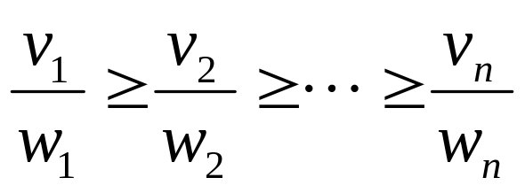
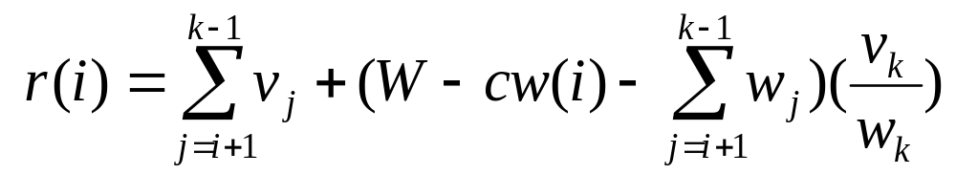
As before, r(i) is calculated as follows:
First, sort the objects in decreasing order of value/weight ahead of time, namely
Consider the level i, the remaining capacity of the knapsack is W-cw, place the remaining objects by greedy strategy into the knapsack until objects k cannot pace into it. SO

Slide 35
n=3,W=30,w=[20,15,15],v=[40,25,25]
dead node
C(i)
A
A
extend node
x₁
0
1
live node
B
B
C
B
C
C
x₂
1
0
1
0
G
F
G
E
F
G
35
E
F
D
E
x₃
1
0
1
0
1
0
K
K
L
L
M
M
N
N
O
H
I
J
K
L
M
N
O
O
35
20
Quene:
-1
B
C
-1
E
F
G
-1
K
L
M
N
O
-1

Slide 36
FIFO
FIFOKnapsack()
1 Enqueue(Q, -1)
2 i ← 1; cw ← 0; cv ← 0; bestv← 0; r ← 0
3 for j ← 2 to n do r ← r+v[j]
4 while Q≠Ø do
5 if C(i)≤W then
6 SaveQueue(Q, cv+v[i], cw+w[i], i, bestv, E, bestE, bestx, 1)
7 if B(i)>bestv then
8 SaveQueue(Q, cv, cw, i, bestv, E, bestE, bestx, 0)
9 E←Dequeue(Q)
10 if E=-1 then
11 if Q=Ø then return bestv
12 Enqueue(Q, -1)
13 E←Dequeue(Q)
14 i ← i+1
15 r ← r-v[i]; cw ← E.weight; cv ← E.value
16 for j ← n-1 downto 1 do
17 bestx[j] ← bestE.Lchild
18 bestE ← bestE.parent
19 return bestv

Slide 37
Max-profit branch and bound
MaxProfitKnapsack()
1 i ← 1
2 uv ← B(1); bestv ←0
3 while i≠n+1 do
4 if C(i) ≤W then
5 if cv+v[i]>bestv then bestv ← cv+v[i]
6 AddLiveNode(uv, cv+v[i], C(i), 1, i+1)
7 uv ← B(i)
8 if B(i)>bestv then
9 AddLiveNode(B(i), cv, cw, 0, i+1)
10 N←ExtractMax(Q); E←N.ptr; cw←N.weight
11 cv ← N.value; uv ← N.upvalue; i ← N.level
12 for j ←n to 1 do
13 bestx[j] ←E.LChild; E ← E.parent
14 return bestv

Slide 38
n=3,W=30,w=[20,15,15], v=[40,25,25]
extend node
C(i)/B(i)
A
A
dead node
x₁
0
1
live node
B
B
C
B
20/56.6
C
C
0/50
x₂
1
0
1
0
F
E
F
G
0/25
E
F
15/50
D
35/65
E
20/56.6
x₃
1
0
1
0
1
0
K
K
L
H
I
J
K
L
C
L
M
N
O
35/65
20/40
30/50
15/25

Slide 39
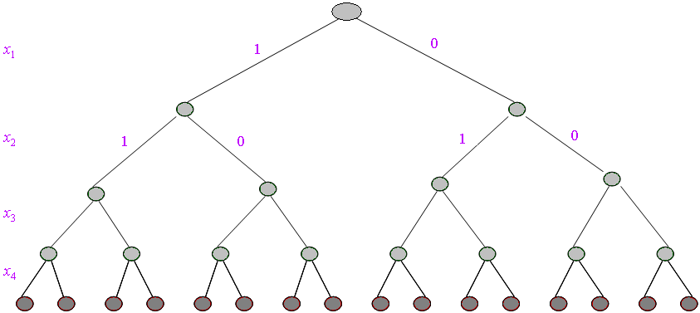
4. SAT problem

Slide 40
ok(i)
1 cn←0
2 for j←1 to n do
3 if C_{j} =0 then return 0
4 else if C_{j} =1 then cn←cn+1
5 return cn
MaxProfitSAT()
1 i ← 1
2 while i≠m+1 do
3 cv←ok(i)
4 if cv >0 then
5 AddLiveNode(cv, 1, i+1)
6 cv←ok(i)
7 if cv >0 then
8 AddLiveNode(cv, 0, i+1)
9 N←ExtractMax(Q); i ← N.level
10 for j ←m downto 1 do
11 bestx[j] ←E.LChild; E ← E.parent

Slide 41
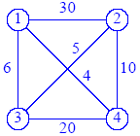
5. Traveling Salesperson Problem
Problem
Given an n vertex network (either directed or undirected) and are to find a cycle of minimum cost that includes all n vertices. Any cycle that includes all n vertices of a network is called a tour. In the traveling-salesperson problem, we are to find a least-cost tour.
Some of the tours in this network are 1,2,4,3,1; 1,3,2,4,1; and 1,4,3,2,1.
The cost of the tour 1,3,2,4,1 is 25, it is the least-cost tour in the network.

Slide 42
Solution space
Since a tour is a cycle that includes all vertices, we may pick any vertex as the start (and hence the end). Let us arbitrarily select vertex 1 as the start and end vertex. Each tour is then described by the vertex sequence 1, x₂,…,x_{n}, 1 when x₂,…,x_{n} is a permutation of (2, 3, …, n). The possible tours may be described by a permutation tree in which each root-to-leaf path defines a tour.
The size of the solution space is 3!

Slide 43
Permutation tree: n=4
x₁
1
x₂
2
3
4
x₃
3
4
2
4
2
3
x₄
2
3
2
4
3
4

Slide 44
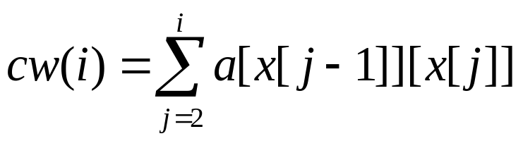
The bounding function
Let the cost of the extend node i be
B(i)=cw(i-1)+w[i-1,i], where,
if B(i)>bestw, then stop search the extend node i and the following level, otherwise, continue to search.
At the same time, the live node with min cost is given priority to extend.

Slide 45
Backtracking
B(i)
x₁
1
0
x₂
2
3
4
30
6
4
x₃
3
4
2
4
2
3
14
24
11
26
x₄
3
2
4
3
4
21
19
29
25
25

Slide 46
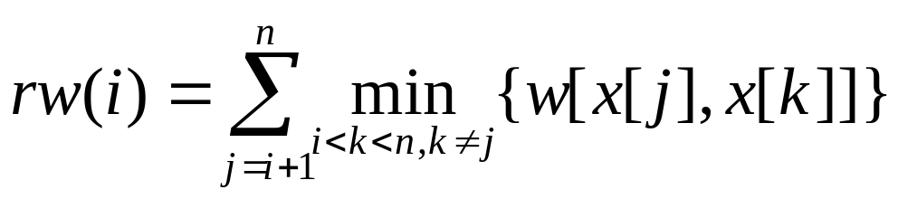
The improved bounding function
Let the cost of the extend node i be
B(i)=cw(i)+rw(i)
where, cw(i) is as before, rw(i) is the sum of costs of least-cost outbound edges from each remaining vertices, namley
if B(i) ≥bestw, then stop search the extend node i and the following level, otherwise, continue to search.
At the same time, the live node with min cost is given priority to extend.

Slide 47
MinWeightTSP()
1 MinSum ← 0
2 for i ← 1 to n do
3 Min ← ∞
4 for j ← 1 to n do
5 if w[i, j] ≠∞ and w[i, j]< Min then Min ←w[i, j]
6 if Min = ∞ then return ∞
7 MinOut[i] ← Min
8 MinSum ← MinSum+Min
9 for i ← 1 to n do E.x[i] ← i
10 E.s←1; E.cw←0; E.rw←MinSum; bestw←∞
11 while E.s < n do
12 if E.s = n-1 then
13 if w[E.x[n-1], E.x[n]] ≠∞ and w[E.x[n], E.x[1]] ≠∞ and
E.cw+ w[E.x[n-1], E.x[n]]+w[E.x[n], E.x[1]]< bestw then
14 bestw←E.cw+ w[E.x[n-1], E.x[n]]+w[E.x[n], E.x[1]]
15 E.cw ← bestw; E.lw ← bestw
16 E.s ←E.s+1
17 Insert(Q, E)

Slide 48
18 else for i ← E.s + 1 to n do
19 if w[E.x[E.s], E.x[i]] ≠ ∞ then
20 cw ← E.cw + w[E.x[E.s], E.x[i]]
21 rw ← E.rw - MinOut[E.x[E.s]]
22 B(i) ← cw + rw
23 if B(i) < bestw then
24 for j ← 1 to n do N.x[j] ← E.x[j]
25 N.x[E.s+1] ← E.x[i]
26 N.x[i] ← E.x[E.s+1]
27 N.cw ← cw; N.s ← E.s + 1
28 N.lw ←B(i); N.rw ← rw
29 Insert(Q, N)
30 E←ExtractMin(Q)
31 if bestw = ∞ return ∞
32 for i ←1 to n do bestx[i] ←E.x[i]
33 return bestw

Slide 49
6. Flow shop scheduling problem
Problem
Given n jobs J=(j₁,j₂,…,j_{n}), Each job has two operations processed by two machines.One machine can only process a single job at a time, and processing must be completed once initiated. Furthermore, machine 2 cannot begin processing a job until machine 1 has completed processing of the same job, namely, Each job must be processed by machine 1 and machine 2 in turn。 Each job i requires a processing time of t[i,j] on the jth machine.

Slide 50
Solution space
A candidate solution to this problem is simply a permutation of the n jobs, namely, (x₁,…,x_{n}) is a permutation of n jobs (1,2, 3, …, n).

Slide 51
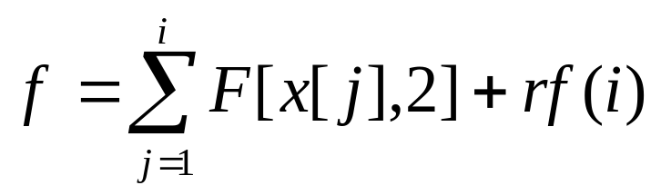
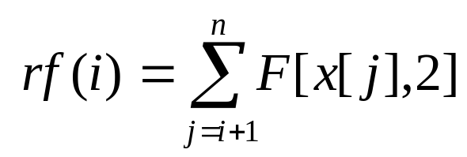
The improved bounding function
Let x={x[1],x[2],…,x[i]} be the set of jobs that has been processed up to the extend node i, then
where
Computing the second item is very difficult, we can estimate its lower bound?

Slide 52
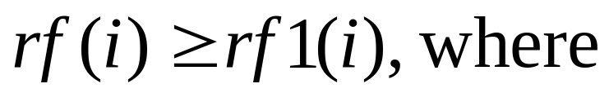
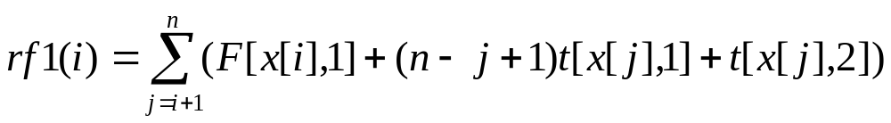
Consider the following two facts:
1) Each remaining job can be continuously processed in the machine 1 and 2 without waiting time, namely, one job is finished in the machine 1, the one can be processed in the machine 2 without waiting, then

Slide 53
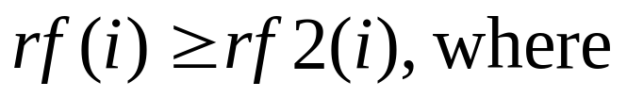





2)The machine 2 has no waiting time, namely, after the machine 2 finished one job, it can process the following job without waiting time.
For the first case 1), if we sort the job by non-decreasing , then we can obtain the smaller , namely,
For the second case 2), if we sort the job by non-decreasing , then we can obtain the smaller , namely,

Slide 54
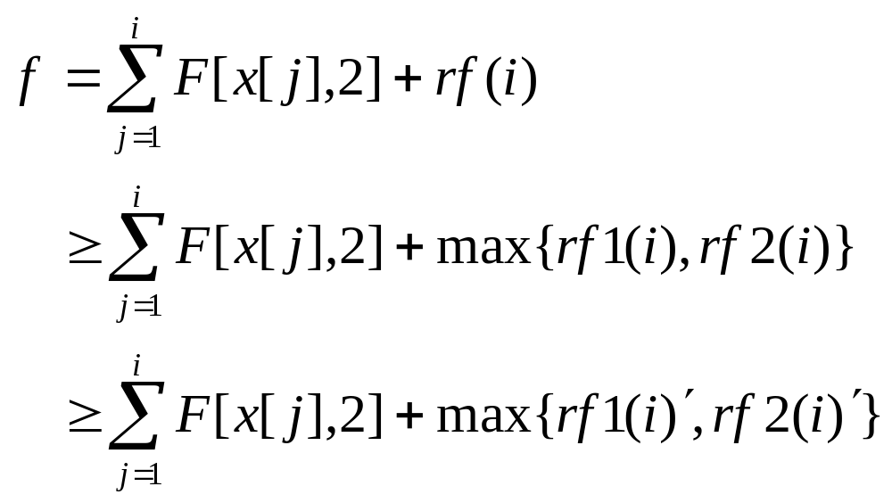
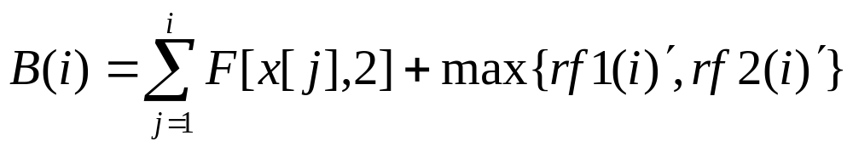
So, we have
Let the cost of the extend node i be

Slide 55
if B(i)≥bestf, then stop search the node i and the following level, otherwise, continue to search.
At the same time, the live node with min cost is given priority to extend.

Slide 56
t_{ij} | machine1 | machine2
j₁ | 2 | 1
j₂ | 3 | 1
j₃ | 2 | 3
B(t)
x₁
1
2
3
19
20
19
x₂
2
3
1
3
19
18
x₃
2
18
18

Slide 57
MinCostFlowShop()
1 E.s←1; E.f ← 0; E.f2 ← 0; E.f1 ← 0
2 for j←1 to n do E.x[j] ←j
3 bestf←∞
4 while E.s≤n do
5 if E.s=n then
6 if E.f<bestf then
7 bestf←E.f
8 for i←0 to n do bestx[i] ←E.x[i]
9 return bestf
10 else for i←E.s+1 to n do
11 for j←1 to n do
12 N.x[j] ←E.x[j]
13 N.x[E.s + 1] ← E.x[i]
14 N.x[i] ← E.x[E.s + 1]
15 f1 ← E.f1 + t[N.x[E.s+1], 1]
16 if E.f2 > f1 then f2 ← E.f2 + t[N.x[E.s + 1], 2]
17 else f2 ← f1 + t[N.x[E.s + 1], 2]
18 N.f ← E.f + f2
19 N.s ← E.s + 1
20 N.f2 ← f2
21 N.f1 ← f1
22 if B(i)<bestf then Insert(Q, N)
23 E←ExtractMin(Q)
24 return bestf

Slide 58
Experiments for 0/1 knapsack
Table 13.1 Experimental results of different algorithms
n | 1000 | 1200 | 1400 | 1600 | 1800 | 2000 | 2200 | 2400
DPKnapsack | 0.109 | 0.187 | 0.203 | 0.296 | 0.421 | 0.578 | 1.125 | 1.218
BacktrackKnapsack | 0.031 | 0.063 | 0.078 | 0.063 | 0.11 | 0.14 | 0.14 | 0.109
MaxProfitKnapsack | 0.015 | 0.015 | 0.031 | 0.031 | 0.031 | 0.062 | 0.046 | 0.046
Optimal value | 282000 | 414610 | 455339 | 607732 | 748955 | 940129 | 1305502 | 1312372

Slide 59
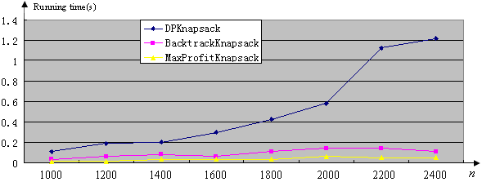

Slide 60
Homework
Page 262-263
  1.Using FIFO and max-cost branch and bound for solving loading problem, and comparing them.

